Slide 1
INTRODUCTION TO
ALGORITHMS
FOURTH EDITION

Slide 2
LECTURE NOTES FOR CHAPTER 10
Elementary Data Structures

Slide 3
CHAPTER 10 OVERVIEW
Goals

Slide 4
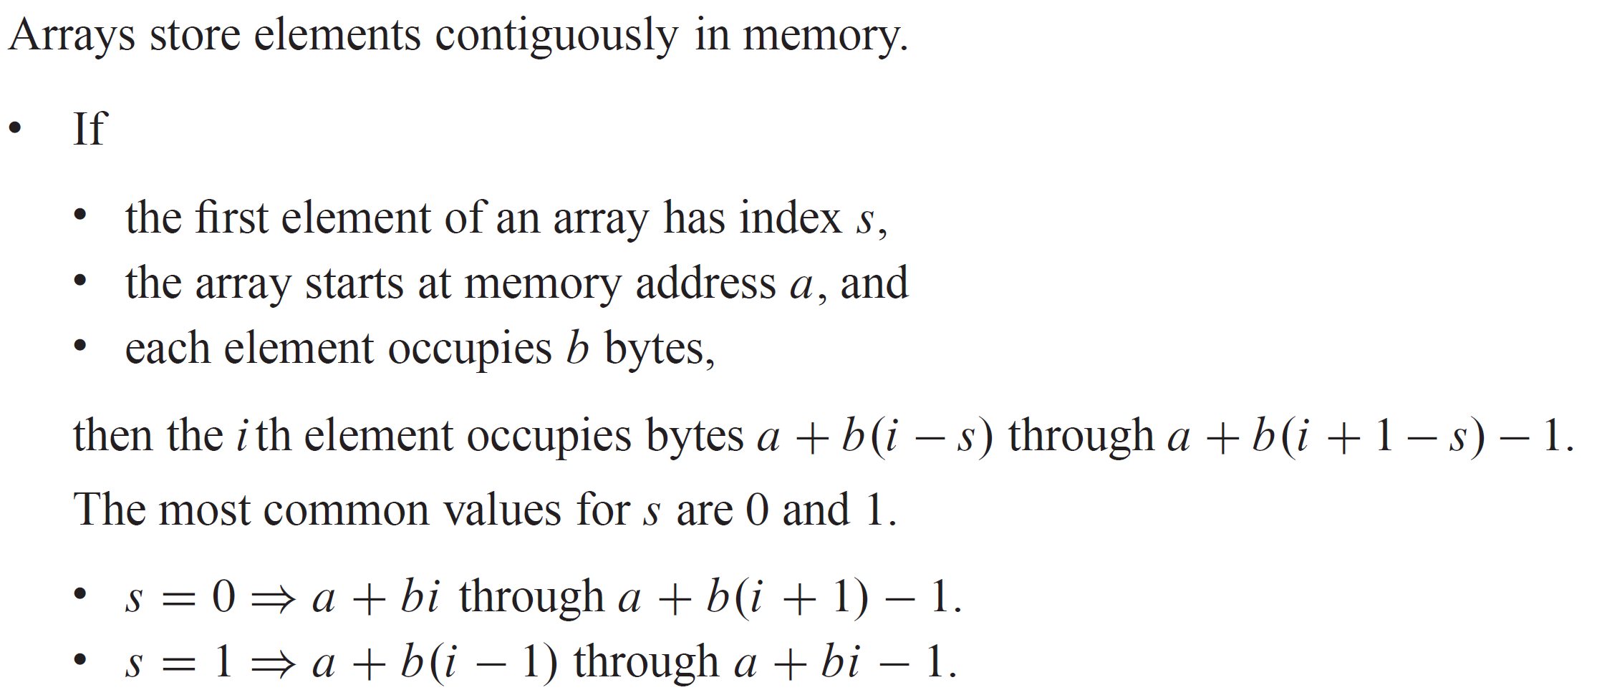
ARRAYS

Slide 5
ARRAYS (continued)
The computer can access any array element in constant time (assuming that the computer can access all memory locations in same amount of time).
If elements of an array occupy different numbers of bytes, elements might be accessed incorrectly or not in constant time. Therefore, most programming languages require that each element of an array must be the same size. Sometimes, pointers to objects are stored instead of objects themselves in order to meet this requirement.

Slide 6
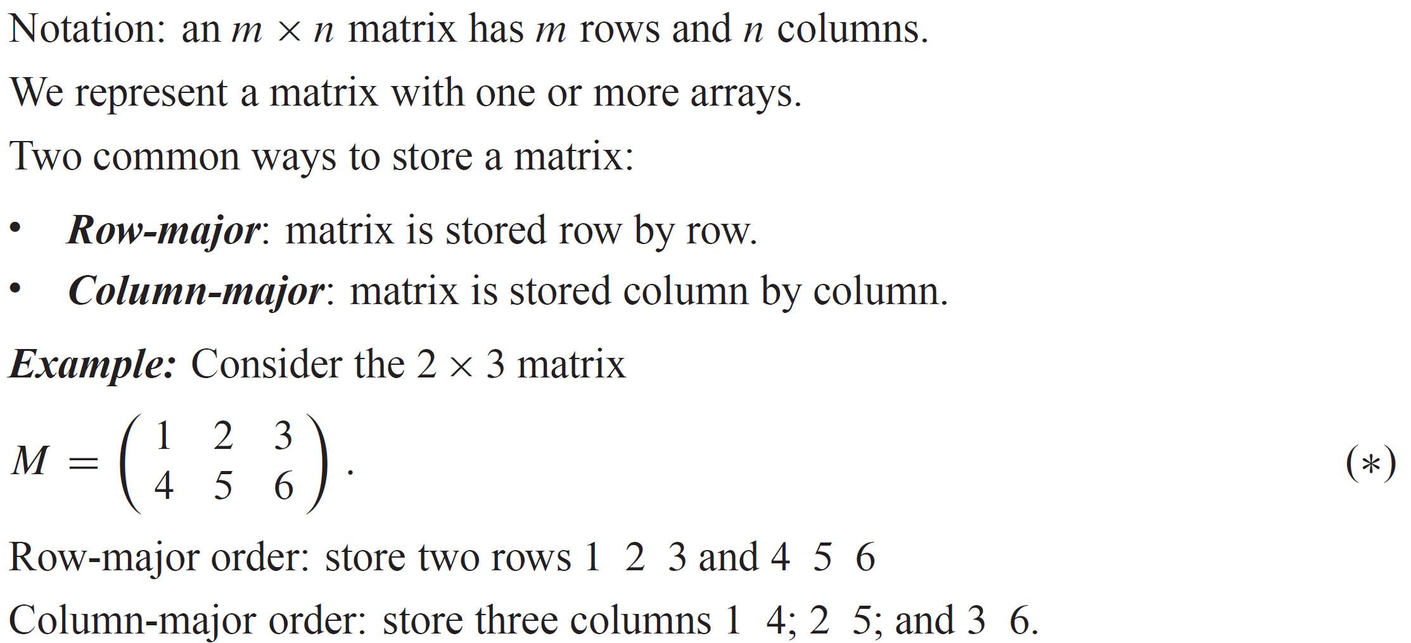
MATRICES

Slide 7
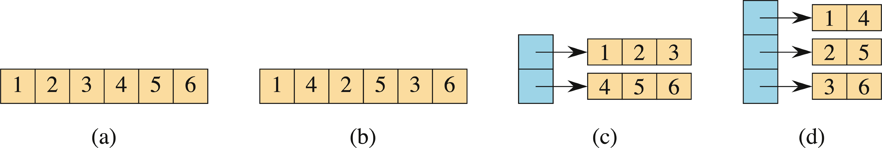
MATRICES (continued)
There are many ways to store M. Shown below, from left to right, are four possible ways:
In row-major order, single array.
In column-major order, single array.
In row-major order, one array per row with a single array of pointers to the row arrays.
In column-major order, one array per column with a single array of pointers to the column arrays.
There are other ways to store matrices.

Slide 8
STACKS AND QUEUES
Stacks and queues are dynamic sets in which the element removed from the set by the DELETE operation is prespecified.
Stack: the element deleted is the one that was most recently inserted. Stacks use a last-in, first-out, or LIFO, policy.
Queue: the element deleted is the one that has been in the set for the longest time. Queues use a first-in, first-out, or FIFO, policy.

Slide 9
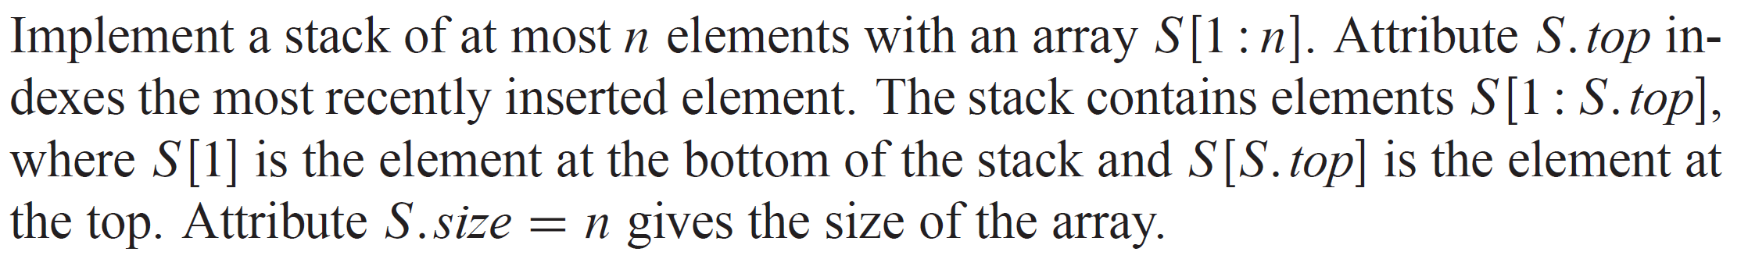
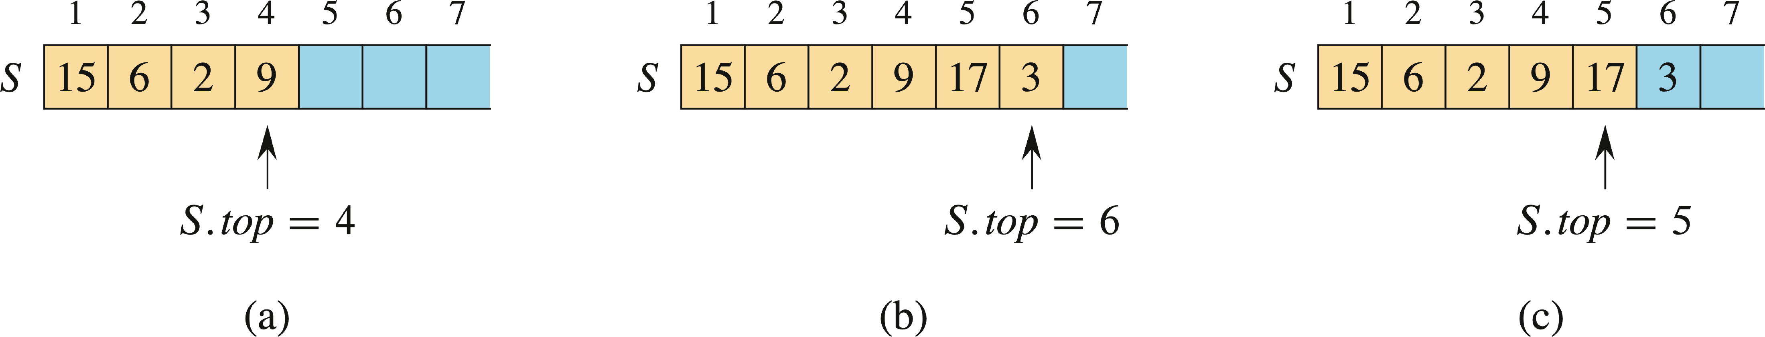
STACKS

Slide 10
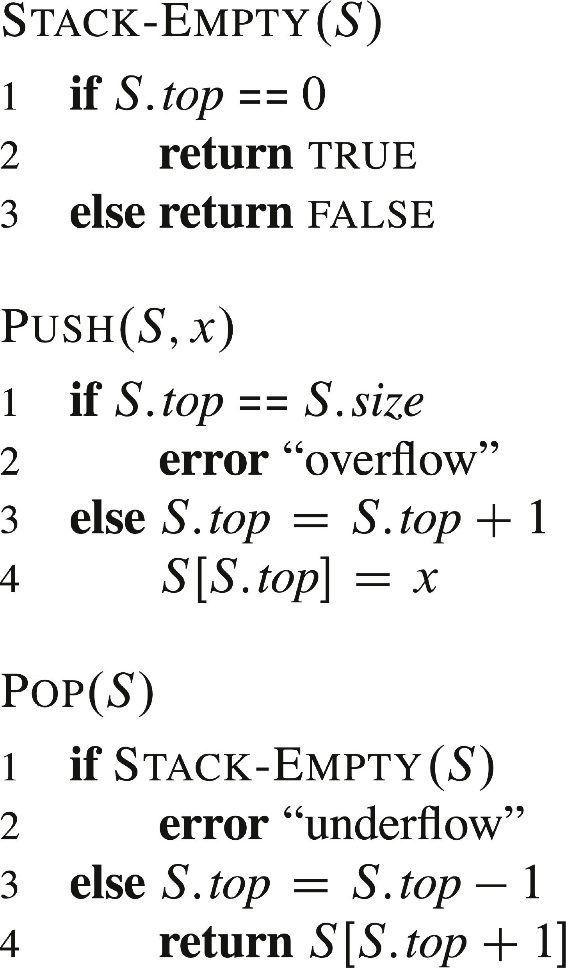
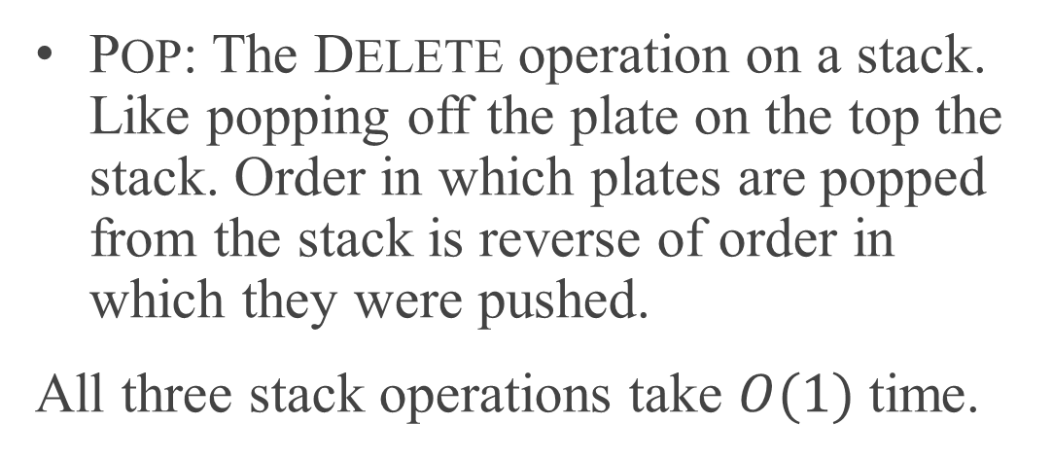
STACKS (continued)
Stack operations: PUSH, POP, STACK-EMPTY.
PUSH: The INSERT operation on a stack. Like pushing a plate on top of a stack of plates in a cafeteria.
POP: The DELETE operation on a stack. Like popping off the plate on the top the stack. Order in which plates are popped from the stack is reverse of order in which they were pushed.
All three stack operations take $O(1)$ time.

Slide 11
QUEUES
Inserting into a queue is enqueuing, and deleting from a queue is dequeuing. The FIFO property of a queue causes it to operate like a line of customers waiting for service. A queue has a head and a tail.
When an element is enqueued, it goes to the tail of the queue, just as a newly arriving customer takes a place at the end of the line.
The element dequeued is the one at the head of the queue, like the customer at the head of the line who has waited the longest.

Slide 12
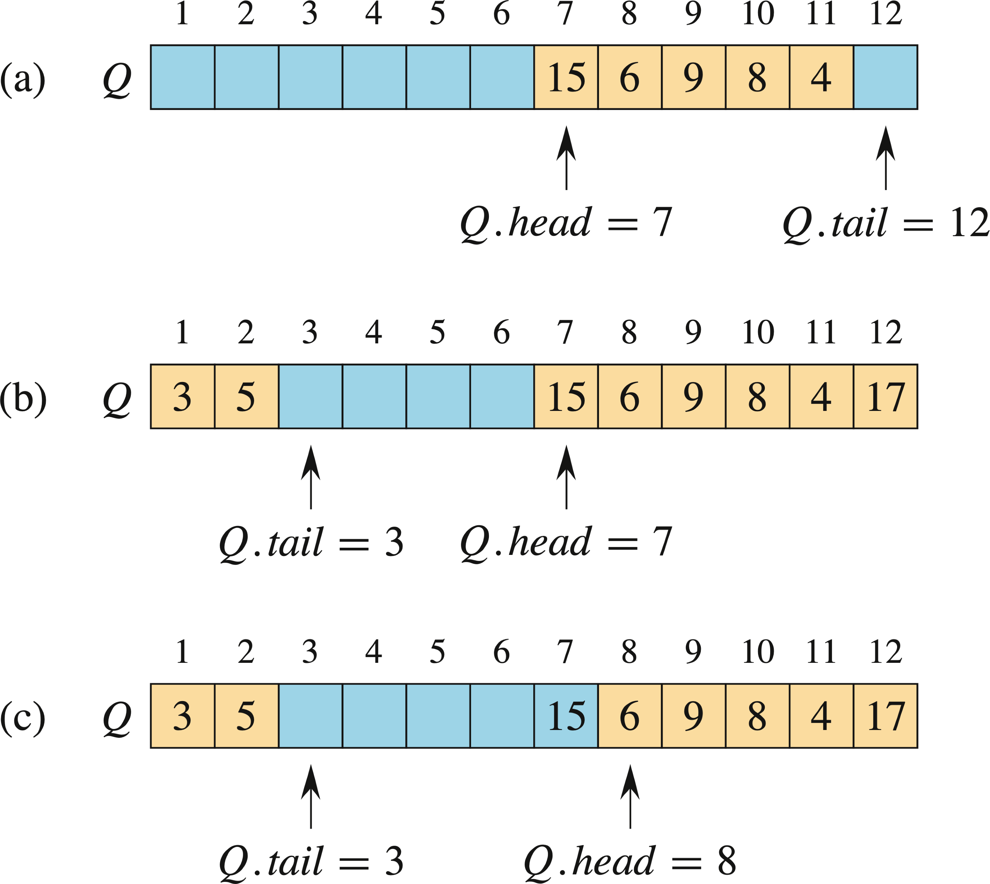

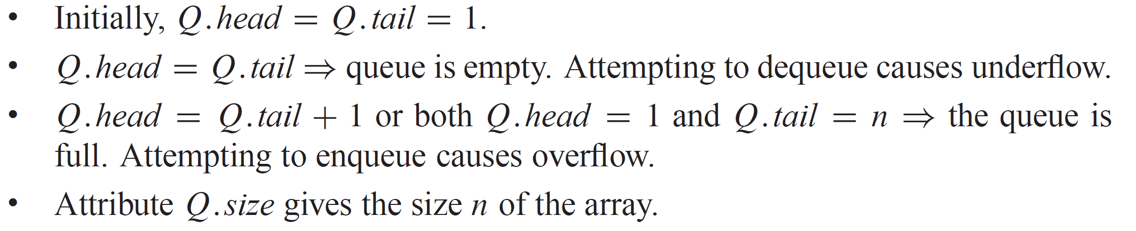
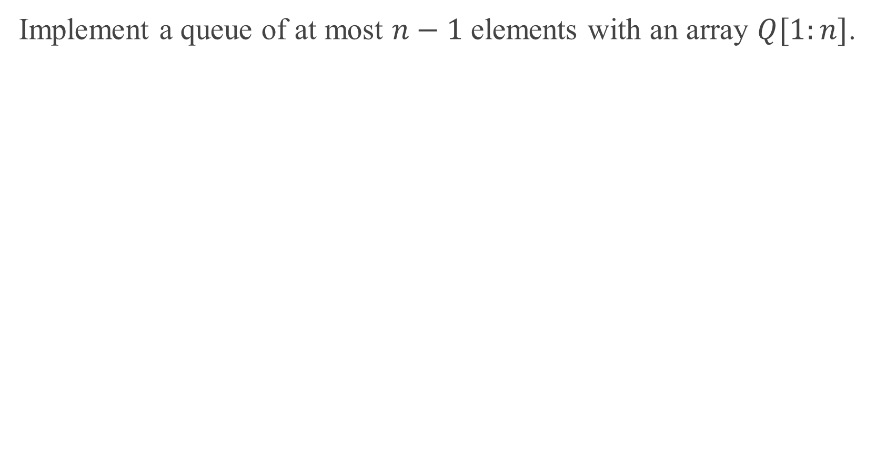
QUEUES (continued)
Implement a queue of at most $n−1$ elements with an array $Q[1:n]$.

Slide 13
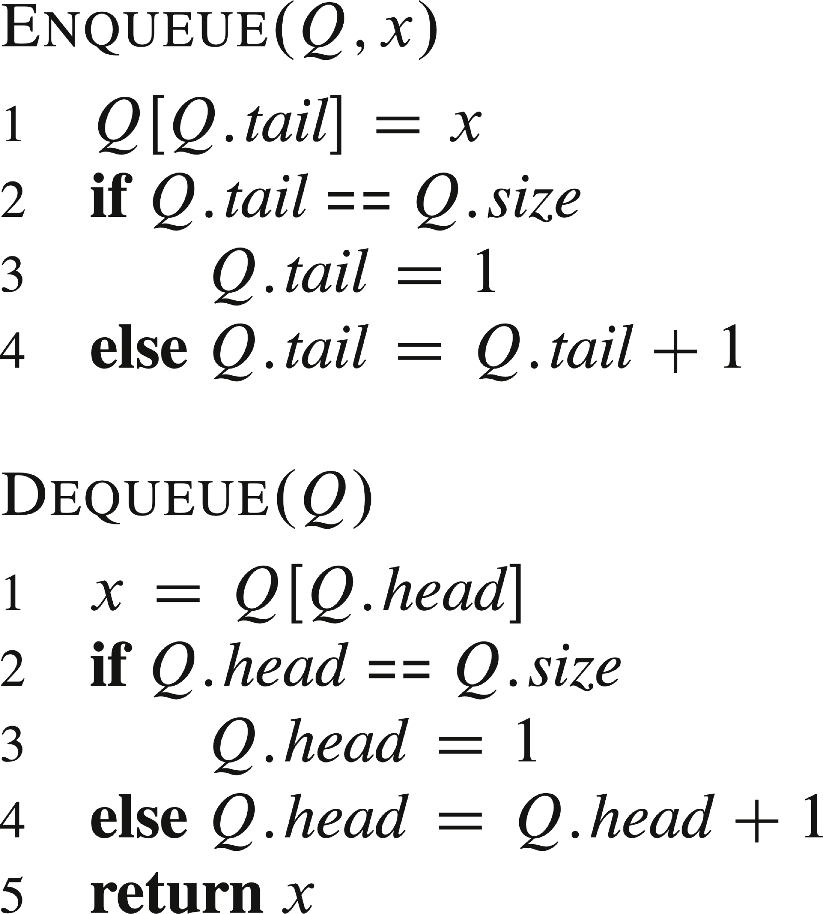
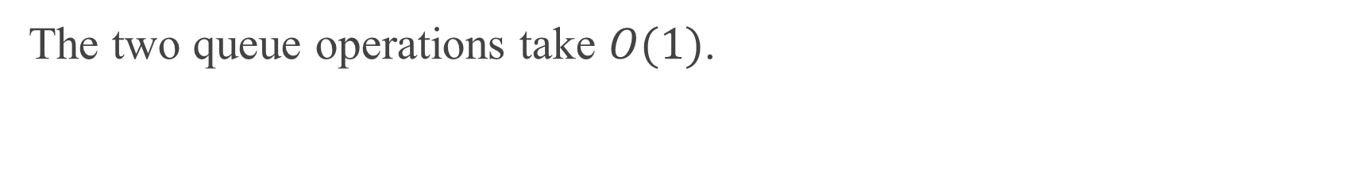
QUEUES (continued)
The two queue operations take $O(1)$.

Slide 14
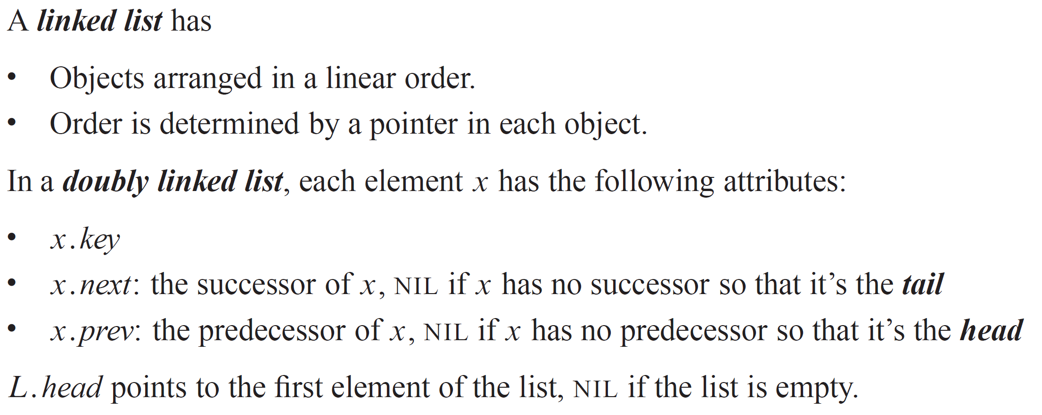
LINKED LISTS

Slide 15
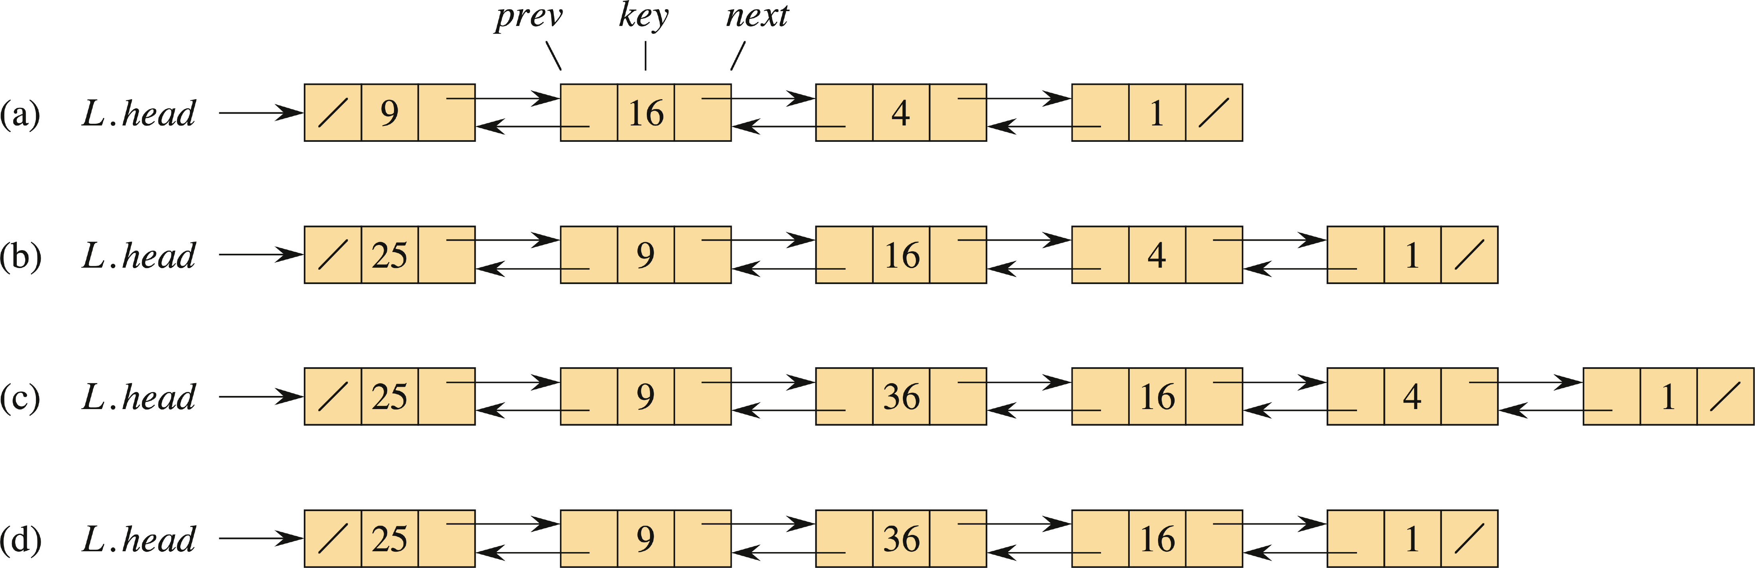
LINKED LISTS (continued)
Linked lists come in several types:
Singly linked: each element has a next attribute but not a prev attribute.
Sorted: the linear order of the list follows the linear order of keys stored in elements of the list.
Unsorted: the elements can appear in any order.
Circular: the prev pointer of the head of the list points to the tail, and the next pointer of the tail of the list points to the head.
Here is a doubly linked list whose elements have keys 9, 16, 4, 1. Slashes indicate NIL.

Slide 16
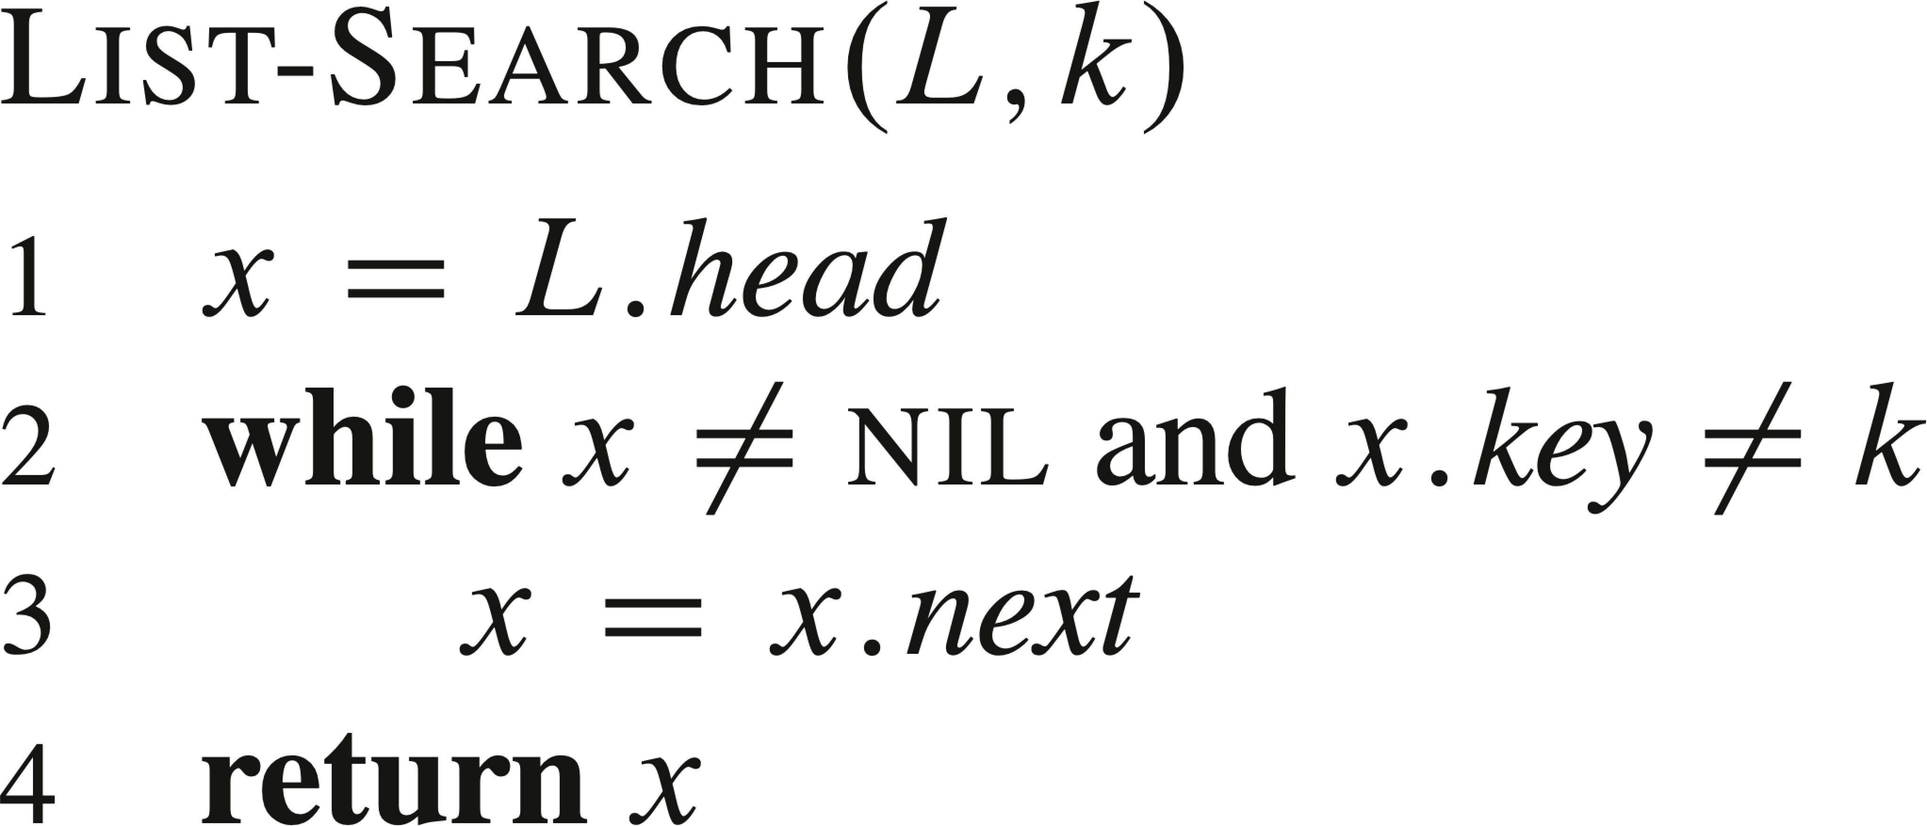
SEARCHING A LINKED LIST

Slide 17
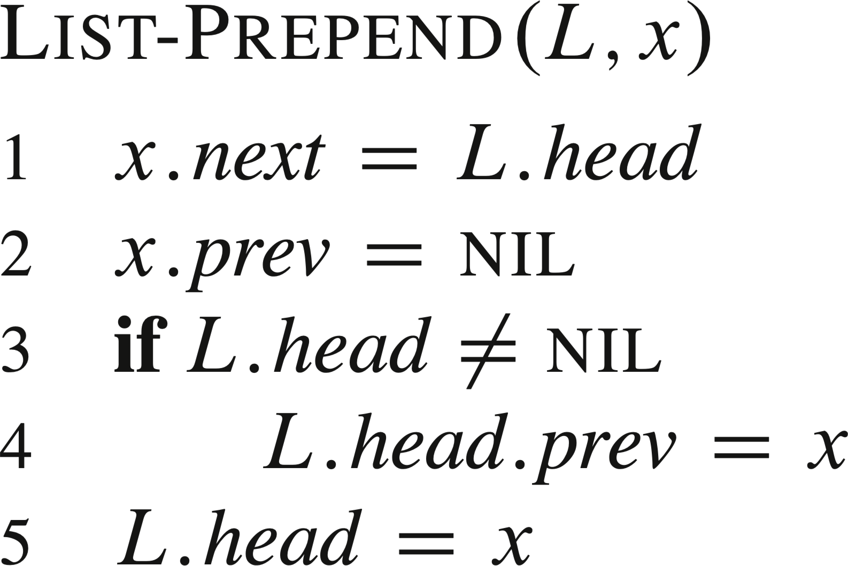
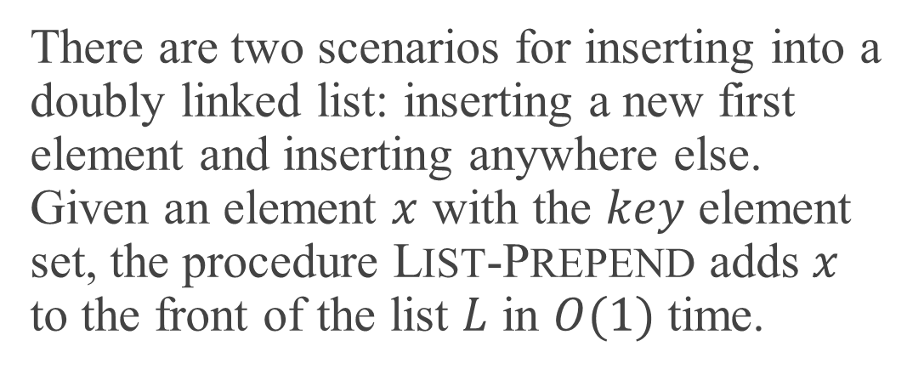
INSERTING INTO A LINKED LIST
There are two scenarios for inserting into a doubly linked list: inserting a new first element and inserting anywhere else. Given an element $x$ with the $key$ element set, the procedure LIST-PREPEND adds $x$ to the front of the list $L$ in $O(1)$ time.
The second figure above shows the result of prepending 25.

Slide 18
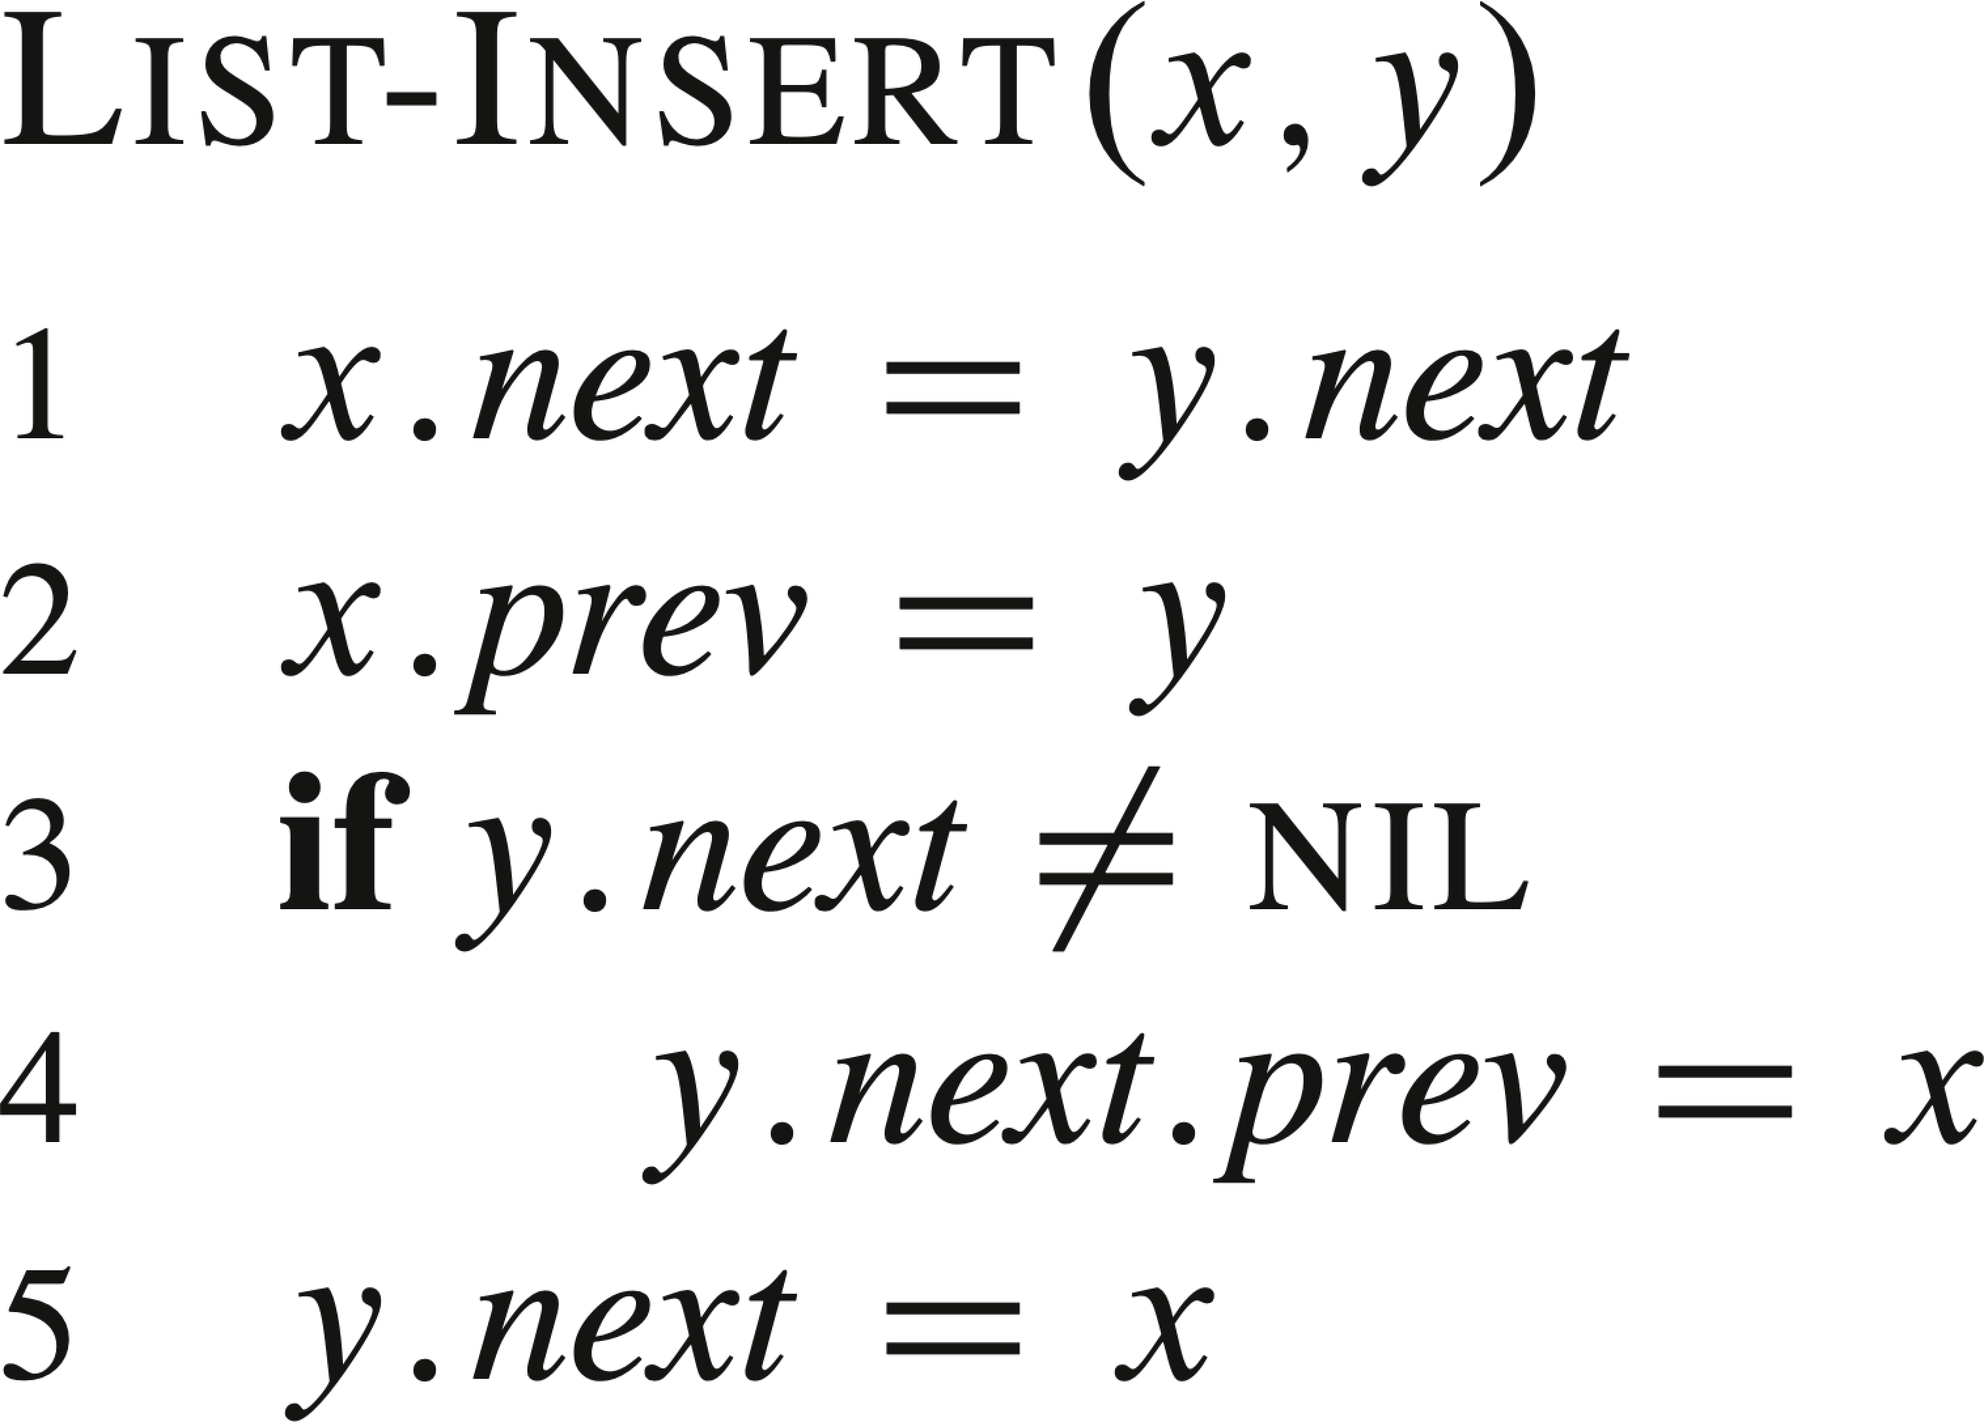
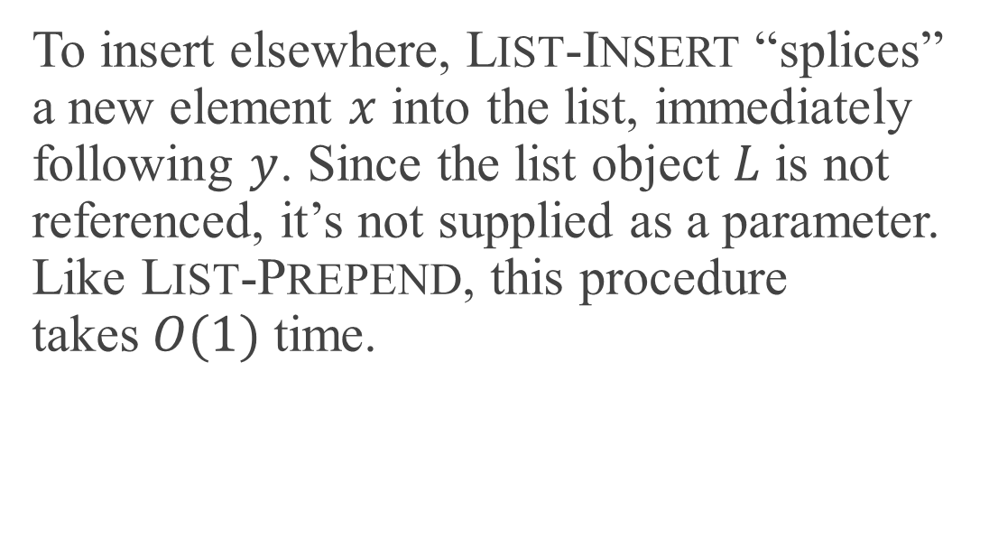
INSERTING INTO A LINKED LIST (continued)
To insert elsewhere, LIST-INSERT “splices” a new element $x$ into the list, immediately following $y$. Since the list object $L$ is not referenced, it’s not supplied as a parameter. Like LIST-PREPEND, this procedure takes$O(1)$ time.
The third figure above shows the result of inserting 36 after 9.

Slide 19
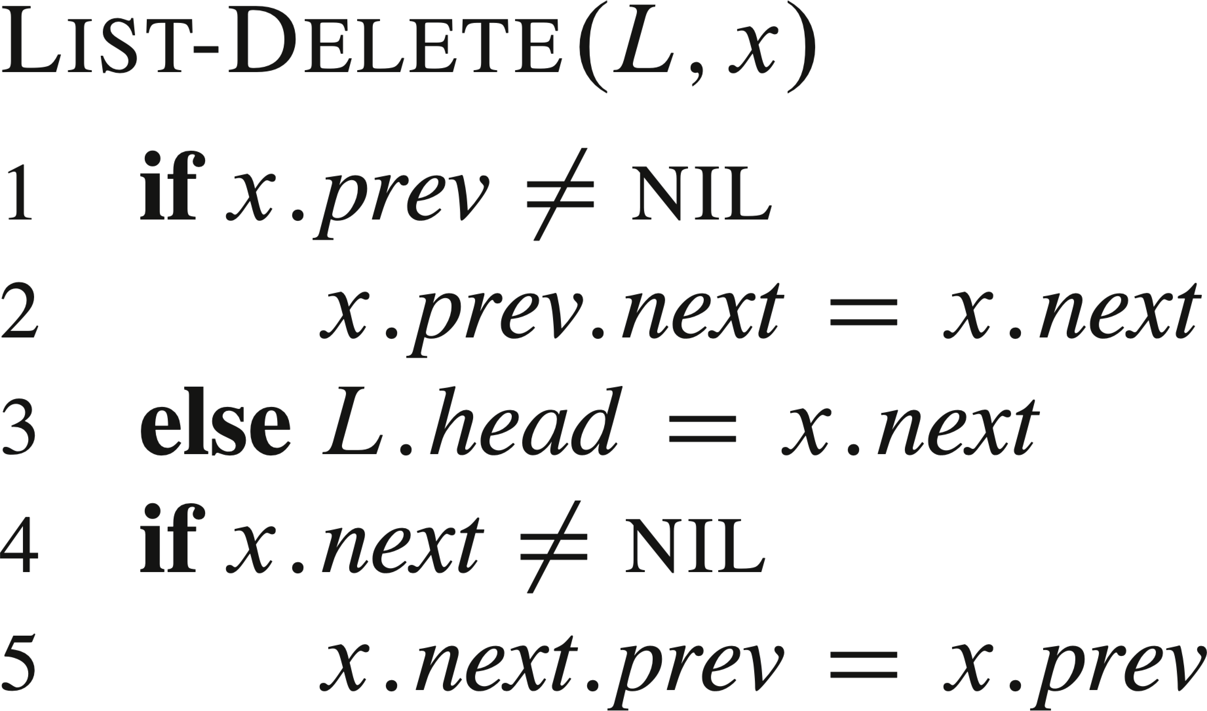

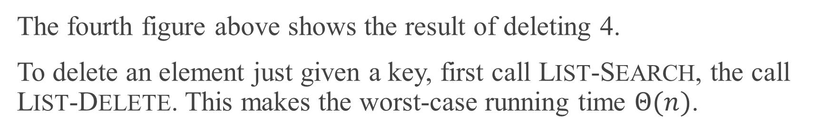
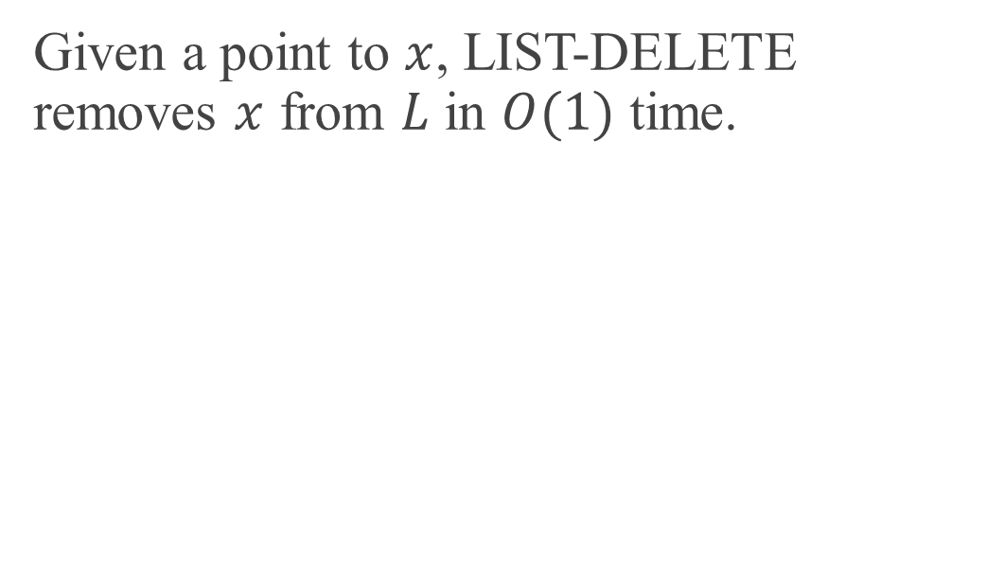
DELETING FROM A LINKED LIST
Given a point to $x$, LIST-DELETE removes $x$ from $L$ in $O(1)$ time.
The fourth figure above shows the result of deleting 4.
To delete an element just given a key, first call LIST-SEARCH, the call LIST-DELETE. This makes the worst-case running time $Θ(n)$.

Slide 20
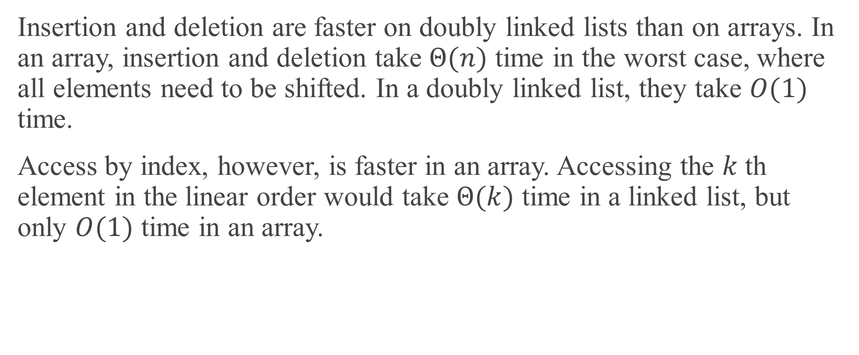
LINKED LIST AND ARRAY PERFORMANCE
Insertion and deletion are faster on doubly linked lists than on arrays. In an array, insertion and deletion take $Θ(n)$ time in the worst case, where all elements need to be shifted. In a doubly linked list, they take $O(1)$ time.
Access by index, however, is faster in an array. Accessing the $k$th element in the linear order would take $Θ(k)$ time in a linked list, but only $O(1)$ time in an array.

Slide 21
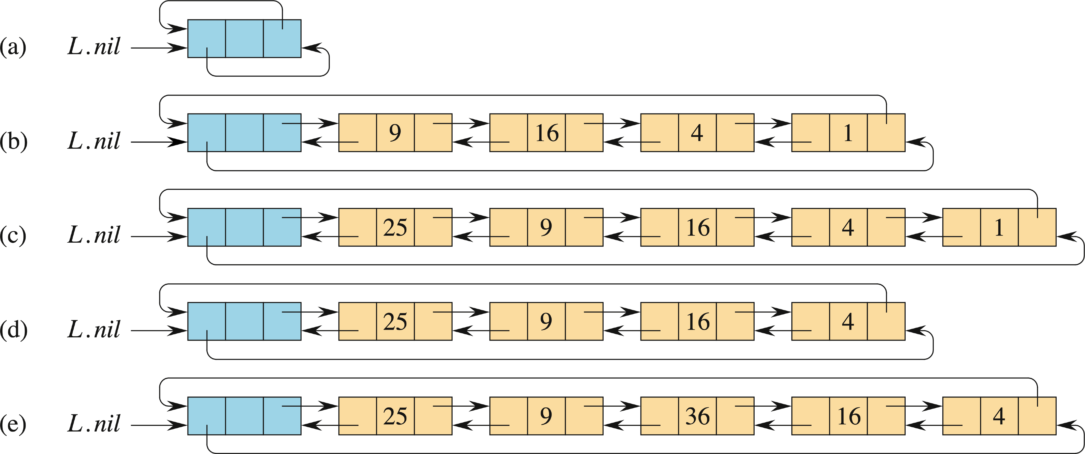
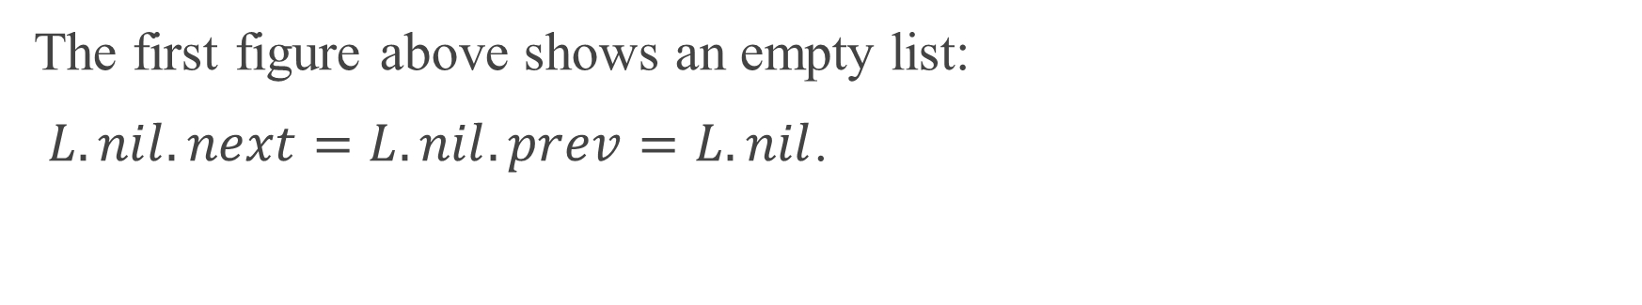
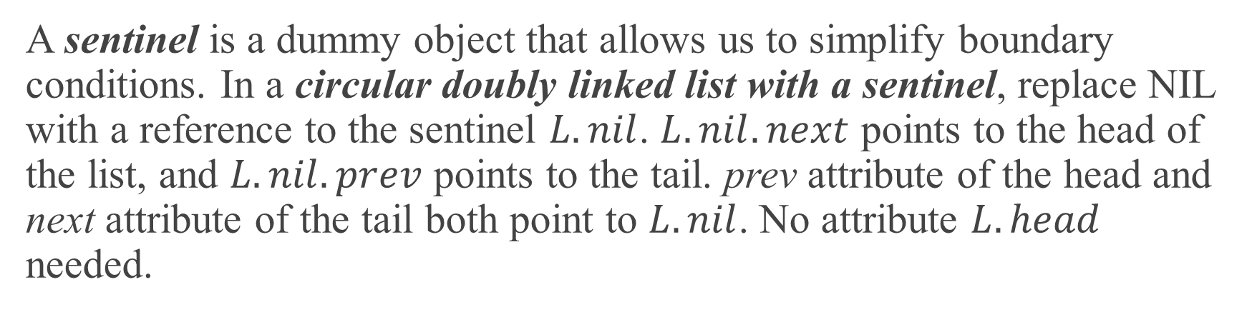
SENTINELS
A sentinel is a dummy object that allows us to simplify boundary conditions. In a circular doubly linked list with a sentinel, replace NIL with a reference to the sentinel $L.nil$. $L.nil.next$ points to the head of the list, and $L.nil.prev$ points to the tail. prev attribute of the head and next attribute of the tail both point to $L.nil$. No attribute $L.head$ needed.
The first figure above shows an empty list:
$L.nil.next=L.nil.prev=L.nil$.

Slide 22
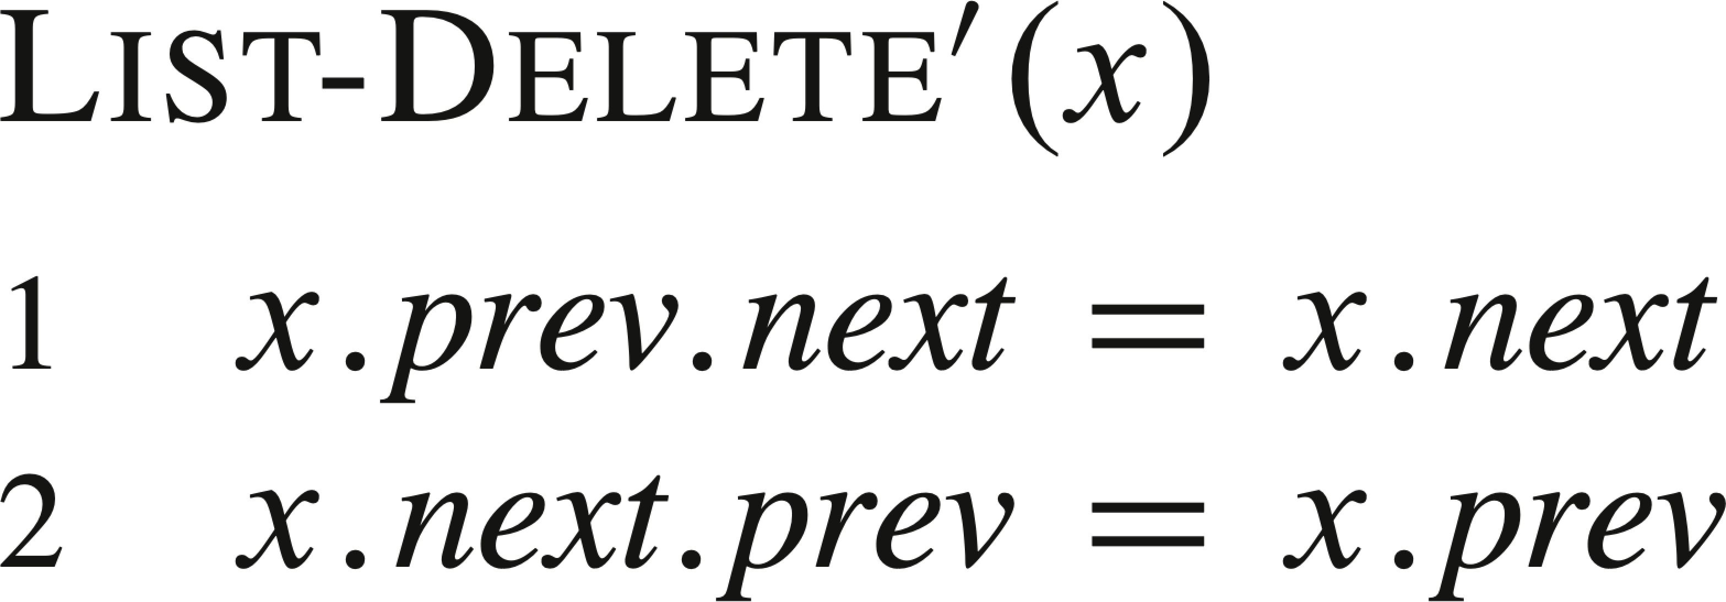
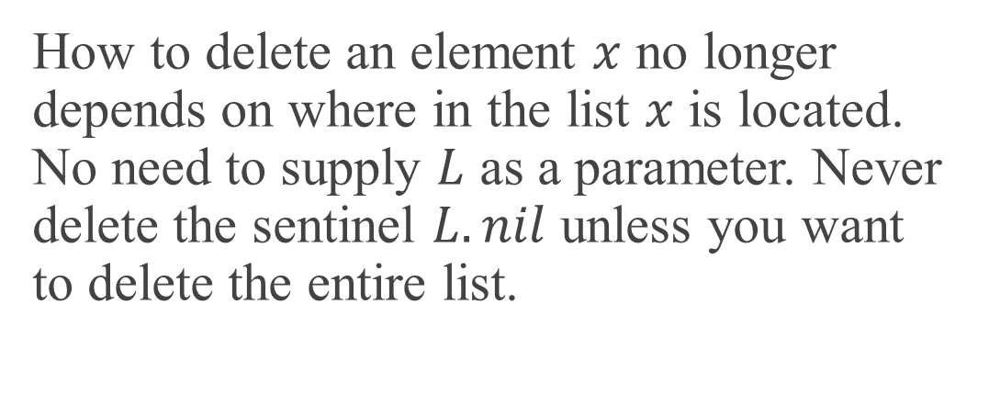
SENTINELS (continued)
The second figure shows a list whole elements have keys 9, 16, 4, 1.
How to delete an element $x$ no longer depends on where in the list $x$ is located. No need to supply $L$ as a parameter. Never delete the sentinel $L.nil$ unless you want to delete the entire list.

Slide 23
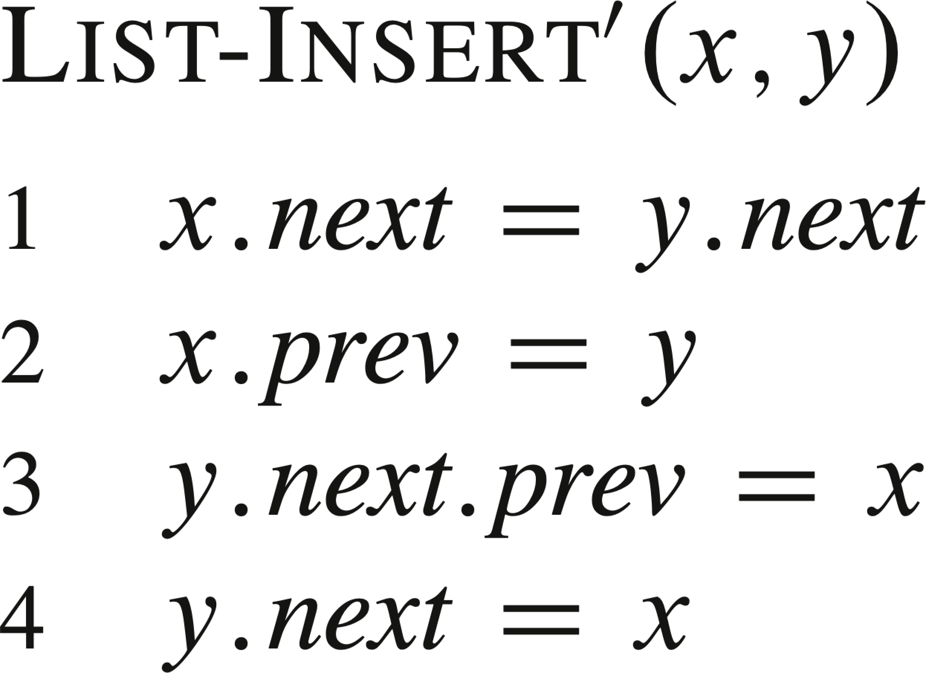
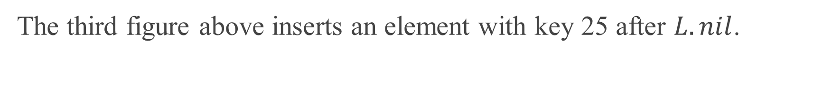
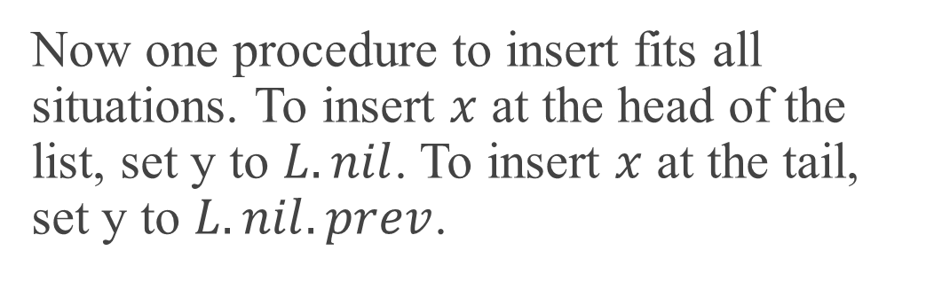
SENTINELS (continued)
Now one procedure to insert fits all situations. To insert $x$ at the head of the list, set y to $L.nil$. To insert $x$ at the tail, set y to $L.nil.prev$.
The third figure above inserts an element with key 25 after $L.nil$.

Slide 24


SENTINELS (continued)
The fourth figure deletes the element with key 1 by calling LIST-DELETE$′(L.nil.prev)$.
The fifth figure inserts an element with key 36 after the element with key 9.

Slide 25
SENTINELS (continued)
Searching has the same asymptotic running time as without a sentinel, but the constant factor can be better by removing one test per loop iteration. Instead of checking first whether the search has hit the end of the list and then, if it hasn’t, whether the key is in the current element, eliminate the check for hitting the end of the list. The trick is to guarantee that the key will be found, by putting it in the sentinel. Start at the head. If the key is really in the list, it will be found before getting back to the sentinel. If the key is not really in the list, it is found only in the sentinel.

Slide 26
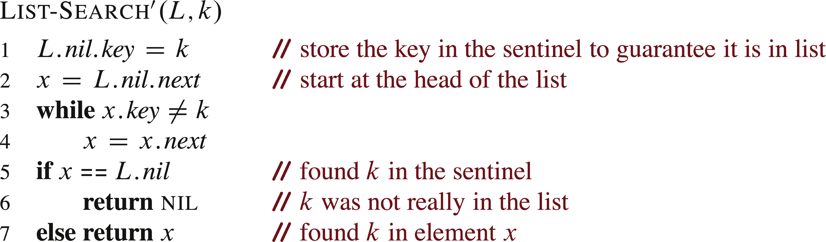
SENTINELS (continued)

Slide 27
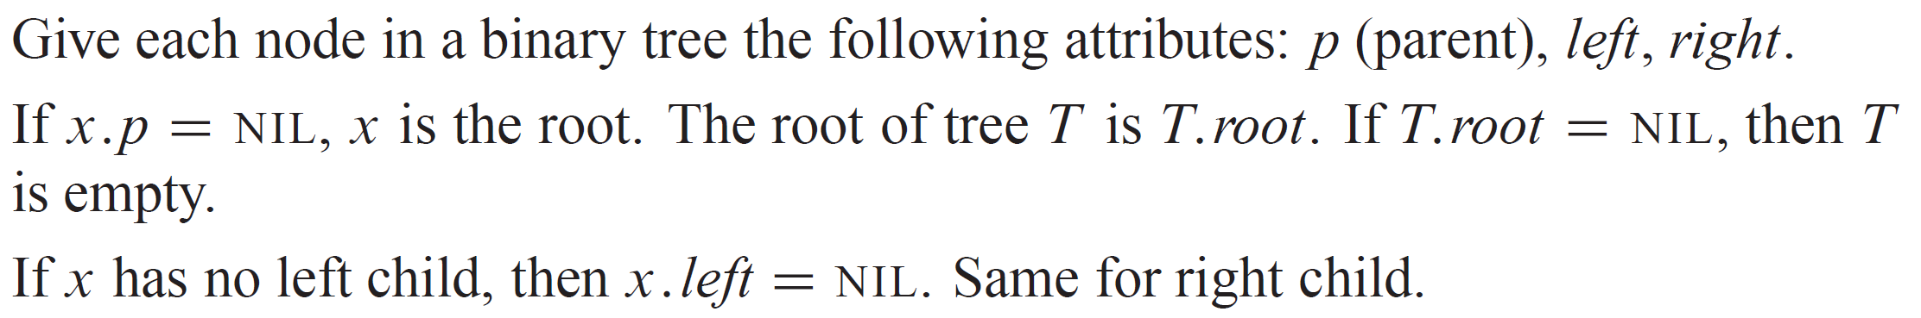
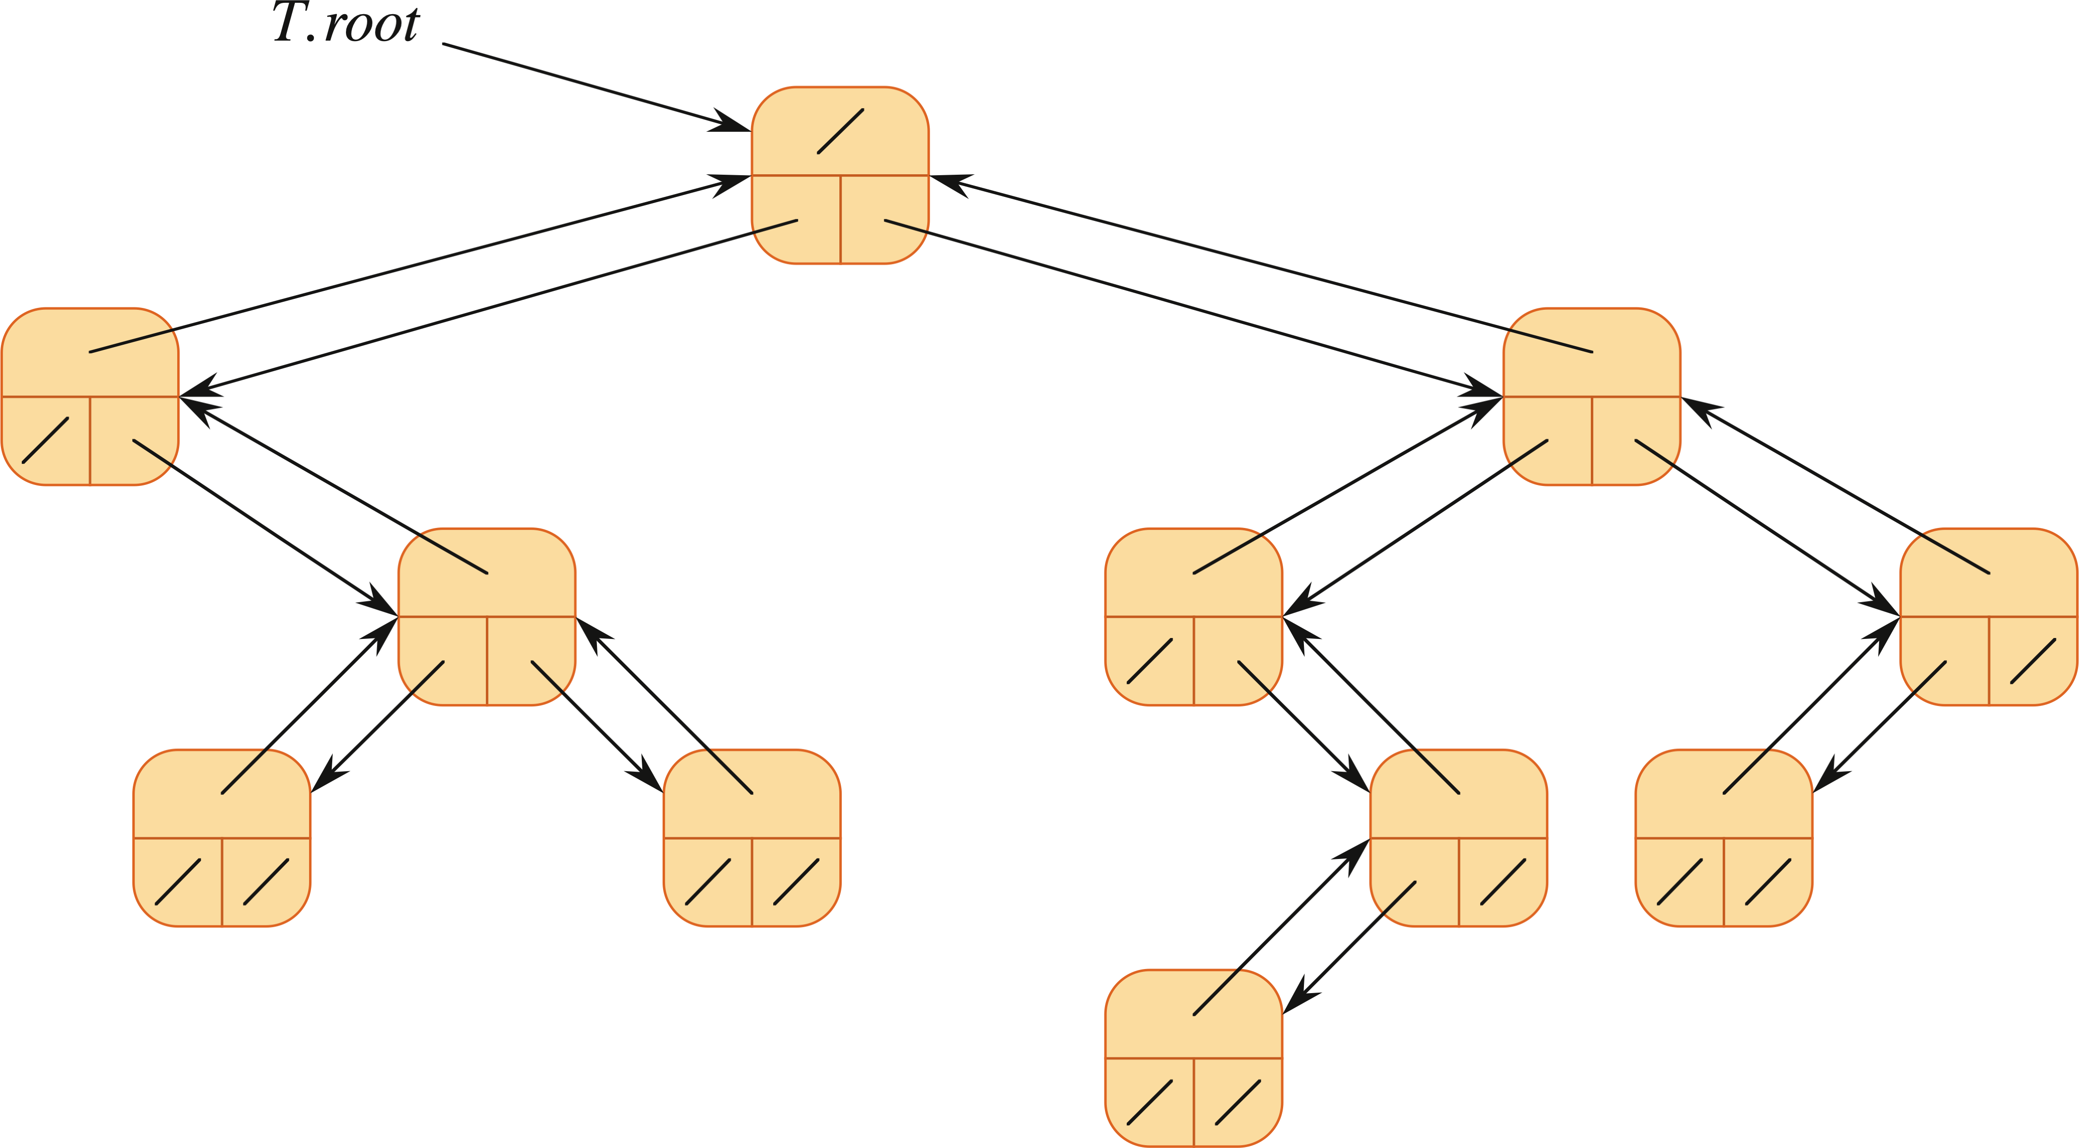
BINARY TREES

Slide 28
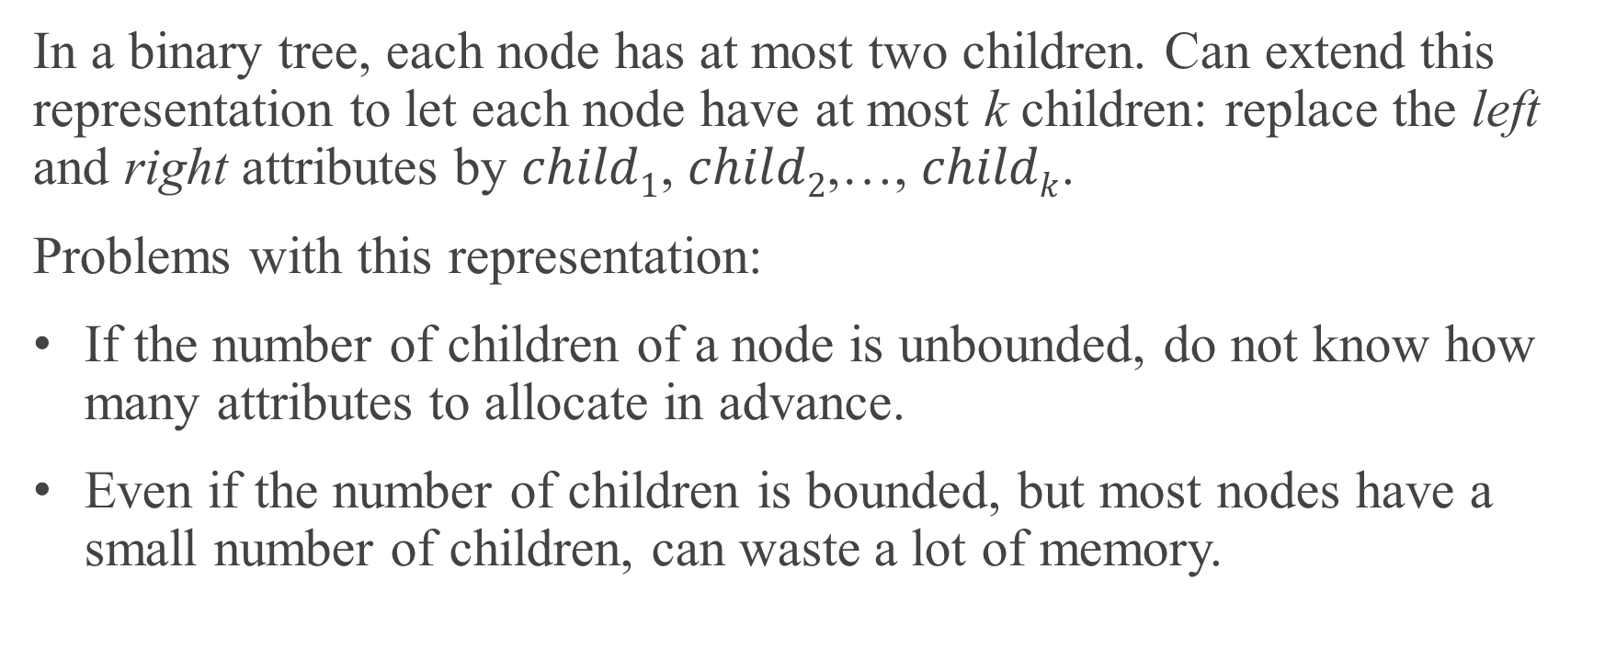
ROOTED TREES WITH UNBOUNDED BRANCHING
In a binary tree, each node has at most two children. Can extend this representation to let each node have at most k children: replace the left and right attributes by $child1$, $child2$,…, $childk$.
Problems with this representation:
If the number of children of a node is unbounded, do not know how many attributes to allocate in advance.
Even if the number of children is bounded, but most nodes have a small number of children, can waste a lot of memory.

Slide 29
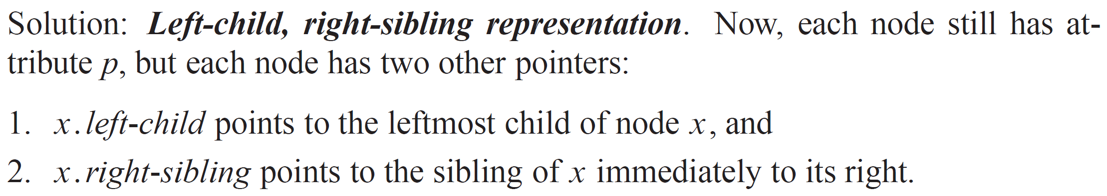
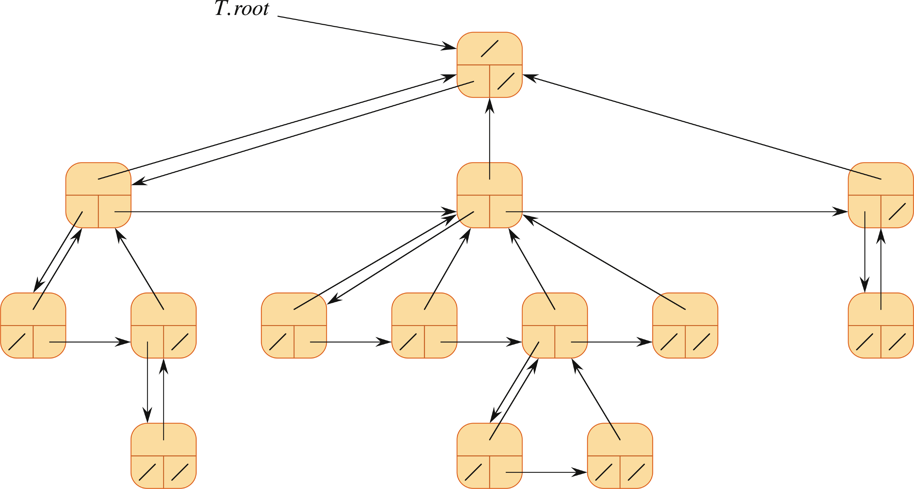
ROOTED TREES WITH UNBOUNDED BRANCHING (continued)
There are other ways to represent rooted trees.

